Slide 1
Hybrid Identity
Name
Title

Slide 2
Agenda
Lab (let’s warm up)
Hybrid Identity Overview
Active Directory Domain Services (AD DS)
Azure Active Directory (AAD)
Azure AD Domain Services (AAD-DS)
Azure AD Connect
Azure Active Directory B2C/B2B
Lab

Slide 3
Lab Setup

Slide 4
Hybrid Identity Overview

Slide 5

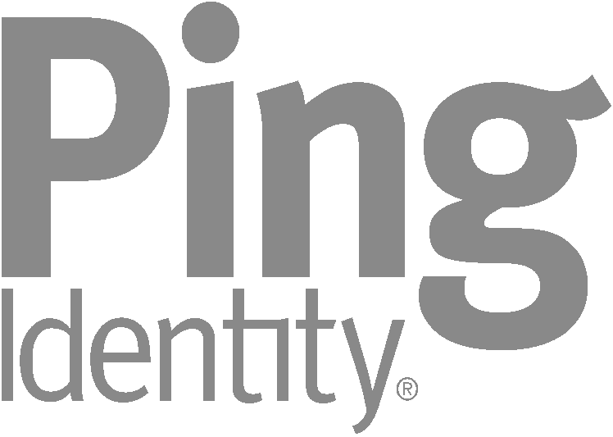
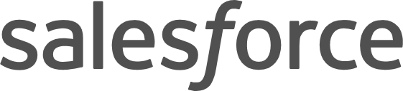









Identity as the Control Plane
Partners
Customers
Public cloud
Commercial IdPs
Azure
Azure Active Directory
Consumer IdPs
Cloud
Windows Server
Active Directory
On- premises
Azure AD Connect
BYO

Slide 6
Active Directory Domain Services (AD-DS)

Slide 7
Active Directory Domain Services (AD DS)
Classic on-prem AuthN/AuthZ service available since Server 2000
90%+ market penetration
Provides forests, domains, Organization Units for logical collection and management of objects (computers, users, groups, etc.)
Requires a domain controller (physical, VM, IaaS VM)
Primary value-add is group policy and local AuthN/AuthZ
Granular management of computer and user settings (aka lock down the desktop)

Slide 8
Common Questions
Can I virtualize a domain controller in an IaaS VM?
Do I need to get rid of my domain controls on-prem?
Are domain controllers going away?
Is Microsoft investing in AD DS?

Slide 9
Azure Active Directory (AAD)

Slide 10
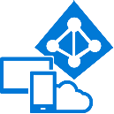










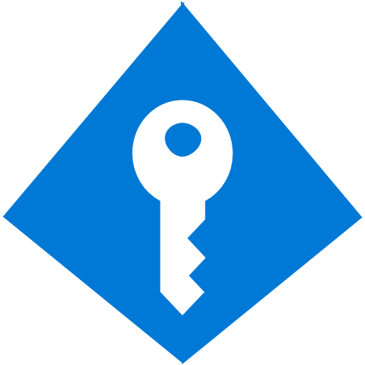
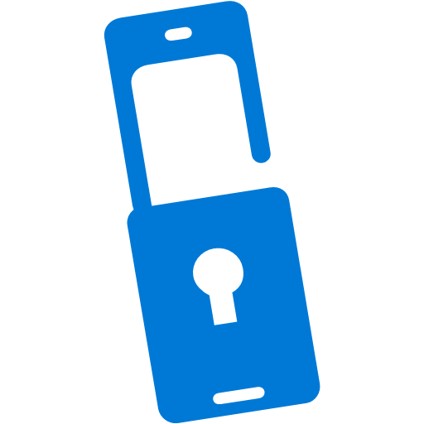



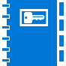


Azure Active Directory in the Marketplace
— Every Office 365 and Microsoft Azure customer uses Azure Active Directory —
14.2 M
1.01B
334 K
64 K
90 %
organizations
identities
3rd party apps
in Azure AD
paid Azure AD / EMS customers
of Fortune 500 companies use Azure AD
Access Reviews
Conditional Access
Multi-Factor Authentication
Addition of custom cloud apps
Remote Access to on-premises apps
Privileged Identity Management
Dynamic Groups
Identity Protection
Azure AD DS
Office 365 App Launcher
Group-Based Licensing
Access Panel/MyApps
Azure AD Connect
Connect Health
Provisioning-Deprovisioning
Azure AD Join
Self-Service capabilities
MDM-auto enrollment /
Enterprise State Roaming
Security Reporting
Governance
HR App Integration
B2B collaboration
Azure AD B2C
SSO to SaaS
Microsoft Authenticator - Password-less Access
+30%
YoY
+35%
YoY
+150%
YoY
+65%
YoY

Slide 11





Azure Active Directory
— Identity and access management for employees, partners, and customers —
John Doe
lllllll
Provide seamless access
Facilitate collaboration
Unlock IT efficiencies
Enhance security and compliance
Notes:
11
IAM for employees, partners, and customers

Slide 12







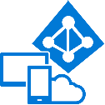

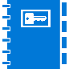



Azure Active Directory
— Identity and access management for employees, partners, and customers —
B2B collaboration
Provisioning-Deprovisioning
Addition of custom cloud apps
Access Panel/MyApps
Dynamic Groups
Identity Protection
Self-Service capabilities
Connect Health
Remote Access to on-premises apps
Azure AD B2C
Group-Based Licensing
Privileged Identity Management
Azure AD Connect
Conditional Access
Microsoft Authenticator - Password-less Access
Azure AD Join
MDM-auto enrollment /
Enterprise State Roaming
Security Reporting
SSO to SaaS
Multi-Factor Authentication
Azure AD DS
Office 365 App Launcher
HR App Integration
Access Reviews
Notes:
12
[keypoint]

Slide 13
Azure Active Directory (AAD)
Microsoft’s multi-tenant cloud based directory and identity management service
Comes in four editions
Free
Basic
Premium P1
Premium P2
Users and groups are created in a flat structure without OUs or GPOs
Authentication is performed through protocols such as SAML, WS-Federation, and OAuth

Slide 14
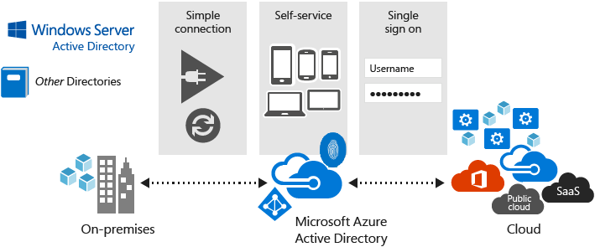
Azure Active Directory (AAD)
Key Features
Single Sign-On (SSO)
Self-Service Password Change
Multi-Factor Authentication (MFA)
AD Join for Windows 10
Company Branding

Slide 15
Azure Active Directory (AAD)
AAD is not Active Directory nor Azure Active Directory – Domain Services! One solutions does not replace the other …
Most customers will need AD and AAD, and you integrate them with Azure AD Connect

Slide 16
Azure Active Directory – Domain Services (AAD-DS)

Slide 17
Azure AD Domain Services
AD DS evolved to the cloud
Provides managed domain services such as domain join, group policy, LDAP, Kerberos/NTLM authentication that are fully compatible with Windows Server Active Directory
Enables you to deploy your workloads in Azure Infrastructure Services without having to worry about maintaining your identity infrastructure
Great for cloud-only customers that do not have any on-premises identity footprint

Slide 18
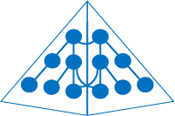
Azure Active Directory Domain Services
Azure
Lift-and-shift on-premises apps to Azure IaaS
Your virtual network
Azure AD
Domain Services
Azure AD Connect
Kerberos
Your Azure IaaS workloads/apps
NTLM
LDAP
Windows Server Active Directory
Group Policy
Azure
Active Directory
On-premises

Slide 19
Azure AD Domain Services
AAD DS does not necessarily mean you replace AD DS!
Feature | Azure AD Domain Services | 'Do-it-yourself' AD in Azure VMs
Managed service | ✓ | ✕
Secure deployments | ✓ | Administrator needs to secure the deployment.
DNS server | ✓ (managed service) | ✓
Domain or Enterprise administrator privileges | ✕ | ✓
Domain join | ✓ | ✓
Domain authentication using NTLM and Kerberos | ✓ | ✓
Kerberos constrained delegation | resource-based | resource-based & account-based
Custom OU structure | ✓ | ✓
Schema extensions | ✕ | ✓
AD domain/forest trusts | ✕ | ✓
LDAP read | ✓ | ✓
Secure LDAP (LDAPS) | ✓ | ✓
LDAP write | ✕ | ✓
Group Policy | Simple | Full
Geo-distributed deployments | ✕ | ✓

Slide 20
AD Connect

Slide 21
Azure AD Connect
Integrate your on-premises directories with Azure Active Directory allowing a common identity for Office 365, Azure, and SaaS applications integrated with Azure AD
Made up of three primary components:
synchronization services
responsible for creating users, groups, and other objects. It is also responsible for making sure identity information for your on-premises users and groups is matching the cloud
monitoring component named Azure AD Connect Health
robust monitoring and provide a central location in the Azure portal to view this activity
optional Active Directory Federation Services component
used to configure a hybrid environment using an on-premises AD FS infrastructure. This can be used by organizations to address complex deployments, such as domain join SSO, enforcement of AD sign-in policy, and smart card or 3rd party MFA.

Slide 22
Azure AD Connect
Optional Features:
Filtering is used when you want to limit which objects are synchronized to Azure AD.
Password synchronization synchronizes the password hash in Active Directory to Azure AD.
Password writeback will allow your users to change and reset their passwords in the cloud and have your on-premises password policy applied.
Device writeback will allow a device registered in Azure AD to be written back to on-premises Active Directory so it can be used for conditional access.
Prevent accidental deletes feature is turned on by default and protects your cloud directory from numerous deletes at the same time. Automatic upgrade is enabled by default for express settings installations and ensures your Azure AD Connect is always up to date with the latest release.

Slide 23

Making a hybrid identity simple
1000s OF APPS, 1 IDENTITY
Azure Active Directory Connect
Azure Active Directory Connect
DirSync
Consolidated deployment assistant for your identity bridge components.
All currently available sync engines will be replaced by the sync engine included in the Connect tool.
Assisted deployment of ADFS will be available through Azure Active Directory Connect.
ADFS is an optional component for authentication in hybrid implementation. Password sync can replace ADFS for more scenarios.
Azure Active Directory Sync
Sync engine
FIM+Azure Active Directory Connector
ADFS
ADFS

Slide 24
Hybrid made easy
Single sign-on
MFA
Self Service
Azure AD Connect
Windows Server Active Directory
Microsoft Azure
Active Directory
On-premises / Private cloud

Slide 25
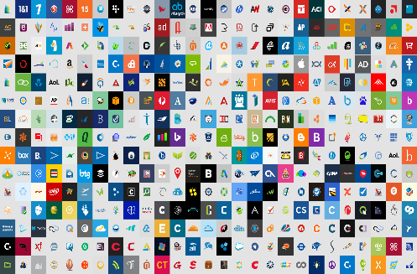
Azure AD Connect authentication options Pass-through authentication
Part 1 of 4
Microsoft Azure Active Directory
Office 365, SaaS, and LoB apps
Pass-through authentication
Pass-through authentication agent
Windows Server Active Directory
On-premises / Private cloud

Slide 26
Azure AD Connect authentication options Password Hash synchronization
Part 2 of 4
Microsoft Azure Active Directory
Office 365, SaaS, and LoB apps
Password Hash synchronization
Windows Server Active Directory
On-premises / Private cloud

Slide 27
Azure AD Connect authentication options Federation via ADFS
Part 3 of 4
Microsoft Azure Active Directory
Office 365, SaaS, and LoB apps
Federation
Windows Server Active Directory
On-premises / Private cloud

Slide 28
Azure AD B2B Azure AD B2C

Slide 29
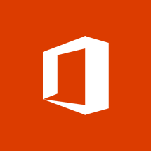












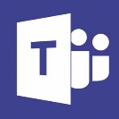




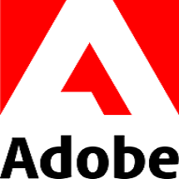


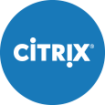
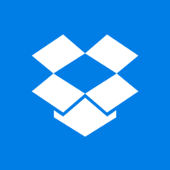

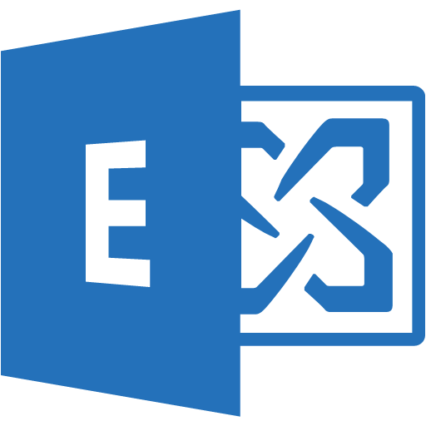





Azure Active Directory B2B collaboration
2,800+ Azure AD integrated SaaS apps
On-premises
Your apps
Line of business apps
Work with any user from any partner
Partners use their own credentials
No requirement for partners to use Azure AD
No external directories or complex set-up required
Simple and secure collaboration
Provide access to any corporate app or data
Seamless user experiences
Enterprise-grade security for apps and data
Azure Active Directory
Directory Services User Management Identity protection Conditional access Application proxy App integration | Federation Services Authentication Services Multi-factor authentication Self-service password reset Role-based access control Identity governance & role management
No management overhead
No external account or password management
No sync or manual account lifecycle management
No external administrative overhead
Any users
MSA accounts
Azure AD accounts
Google* accounts
Employee accounts
Other Identity Provider* accounts
Notes:
You can choose any type or combination of user accounts from a wide variety of identity providers.
…and manage them using Azure Active Directory, and all of the features and services it provides.
…and through Azure AD give any or all of those users access to the many Azure AD integrated app and on-premises apps that your organization owns or has licensed.
Azure AD Integrated apps section: Office365, SharePoint, Exchange, VS, Teams, and PowerBI - These are the icons that come directly from the Azure Marketplace and what the IT admins would see.
On-premises section: I played with best way to show this but there are improvements to be made. The must haves for this section are showing Line of Business (LOB) apps and SharePoint.

Slide 30
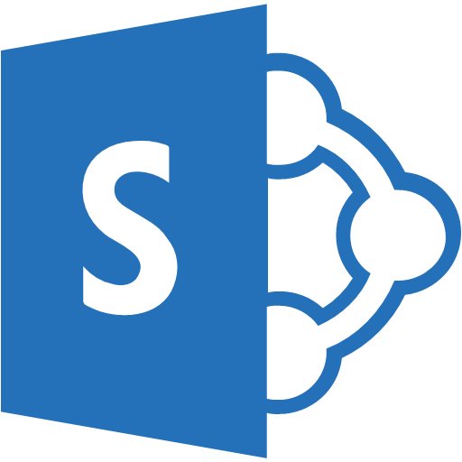
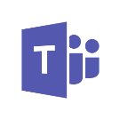

Azure AD B2B collaboration
Other organizations
Assign B2B users access to any app or service your organization owns
SharePoint Online & Office 365 apps
Add B2B users with accounts in other Azure AD organizations
Microsoft Azure
Active Directory
Other Identity
Providers*
Microsoft Account
Add B2B users with MSA or other Identity Provider accounts
On- premises

Slide 31









Azure Active Directory B2C
Securely authenticate your customers using their preferred identity provider
Analytics
Microsoft Azure
Active Directory
Capture login, preference, and conversion data for customers
Provide branded (white-label) registration and login experiences
contoso
Social IDs
Business & Government IDs
Customers
Apps

Slide 32
Lab Setup

Slide 33
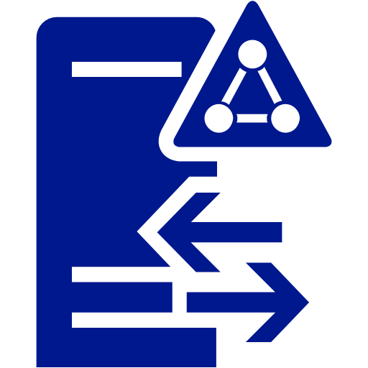
Lab Architecture
Active Directory Domain Services
(AD DS)
Azure
AD Connect
Azure
Active Directory
(AAD)

